Slide 1
Chap 4
The Sequence Alignment Problem

Slide 2
The Sequence Alignment Problem
Introduction
  What, Who, Where, Why, When, How
The Sequence Alignment Problem
The Local Alignment Problem
The Affine Gap Penalty

Slide 3
Introduction
What
  Input: Two (or more) sequences S₁, S₂, …, S_{n}, and a scoring function f.
  Output: The alignment of S₁, S₂, …, S_{n}, which has the optimal score.
Who
  Biologists want to know the secrets of DNA sequences.
  Computerists take it as an interesting problem.

Slide 4
Introduction (Cont’)
Where
  Bioinformatics.
Why
  To determine how close two species are.
  Data compression.
When
  Constructing evolutionary trees.
How
  This is why we are here.

Slide 5
The Sequence Alignment Problem
S¹=GAACTG, S²=GAGCTG,
A scoring function f is
  +2 if S¹_{i} is aligned with S²_{j}, and S¹_{i} = S²_{j}
  -1 if otherwise.
GAACTG---
GA---GCTG
Score = 3x(+2)+6x(-1) =0
GAACTG
GAGCTG
Score = 5x(+2)+1x(-1) =9

Slide 6
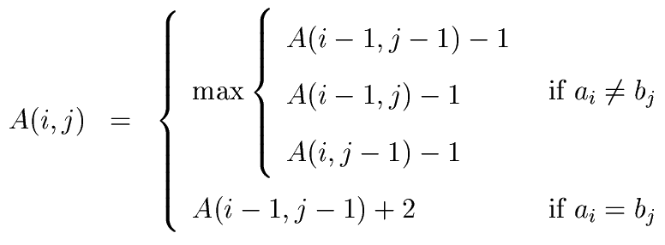
The Dynamic Programming Approach

Slide 7
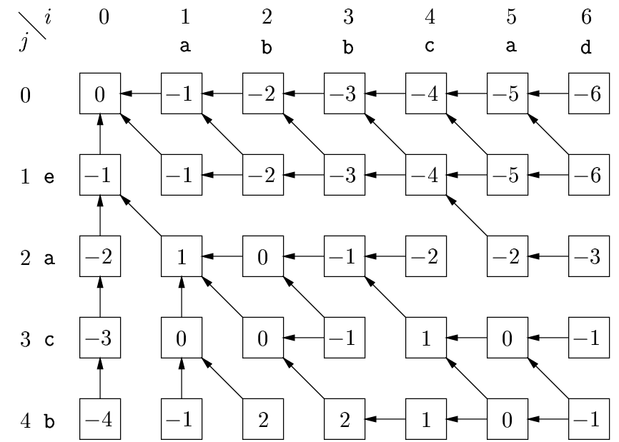
The Dynamic Programming Approach(Cont’)

Slide 8
The Local Alignment Problem
Input:Two (or more) sequences S₁, S₂, …, S_{n}, and a scoring function f.
Output: Subsequences S_{i}’of S_{i} such that the score obtained by aligning S_{i}’ is highest, among all possible subsequences of S_{i}. (1<= i <=n)
S₁=abbbcc
S₂=adddcc
Score=3x2+3x(-1)=3
S₁’=cc
S₂’=cc
Score=2x2=4

Slide 9
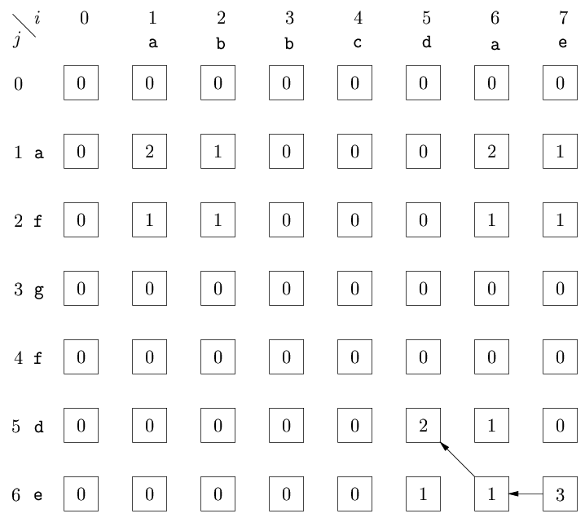
The Local Alignment Problem(Cont’)

Slide 10
The Affine Gap Penalty
Consider the following two sequences
  S₁=ACTTGATCC
  S₂=AGTTAGTAGTCC
An optimal alignment of the above pair of sequences is as follows.
  S₁=ACTT-G-A-TCC
  S₂=AGTTAGTAGTCC Original Score=12
Gap concerned alignment is as follows.
  S₁=ACTT---GATCC
  S₂=AGTTAGTAGTCC Original Score=6

Slide 11
The Affine Gap Penalty(Cont’)
A gap is caused by a mutational event which removed a sequence of residues.
A simple mutational event is more likely than several events.
Therefore a long gap is often more preferable than several gaps.
An affine gap penalty is defined as P_{g}+kP_{e} for a gap with k, k>=1, spaces where P_{g},P_{e} >= 0.

Slide 12
The Affine Gap Penalty(Cont’)
Using our previous scoring function and further let P_{g}=4 and P_{e}=1.
  S₁=ACTT-G-A-TCC
  S₂=AGTTAGTAGTCC
  Score = 8x2-1-3x(4+1x1)=16-1-15=0
  S₁=ACTT-G-A-TCC
  S₂=AGTTAGTAGTCC
  Score=6x2-3x1-(4+3x1)=12-3-7=2

Slide 13
The Multiple Sequence Alignment Problem
Consider the following case where three sequence are involved.
S₁ = ATTCGAT
S₂ = TTGAG
S₃ = ATGCT

Slide 14
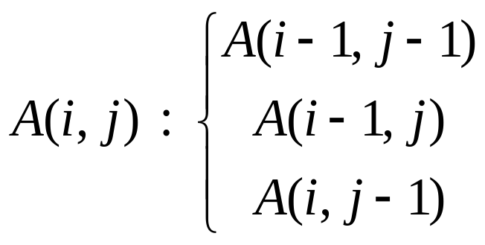
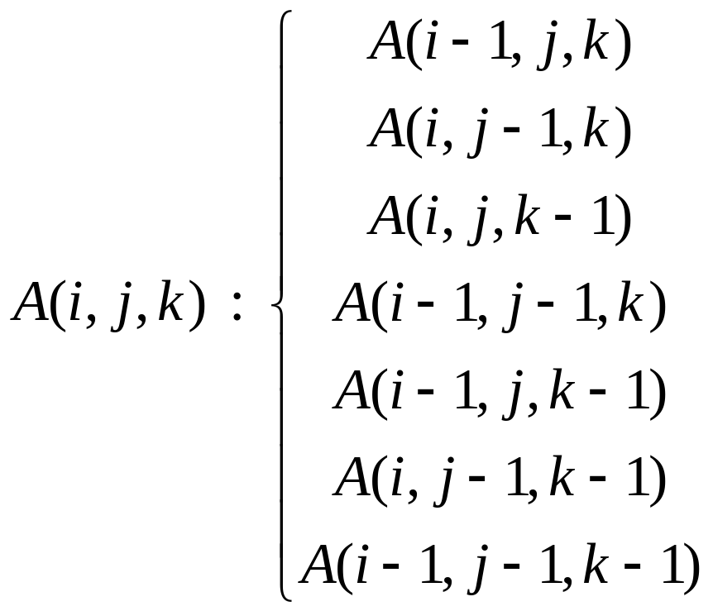
In two sequences alignment problem.
In three sequences alignment problem.

Slide 15
Avery good alignment of these three sequence is now shown as follows. S₁ = ATTCGAT S₂ = -TT-GAG S₃ = AT--GCT
It is noted that the alignment between every pair of sequence is quite good.

Slide 16
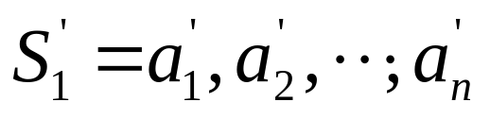
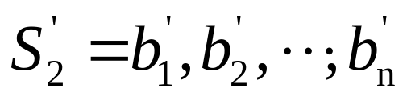
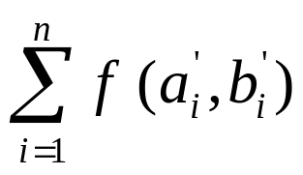
The Gusfield Approximation Algorithm for the Sum of Pairs Multiple Sequence Alignment Problem
We define
The distance between the two sequences induced by the alignment is define as

Slide 17

d(S_{i},S_{j}) has the following characteristics:
d(S_{i},S_{i}) = 0
d(S_{i},S_{j})+ d(S_{i},S_{k}) d(S_{j},S_{k})
Give two sequences S_{i} and S_{j}, the minimum induced distance is denoted as D(S_{i},S_{j}).

Slide 18
S₁ = ATGCTC S₂ = AGAGC S₃ = TTCTG S₄ = ATTGCATGC
We align the for sequence in pair.
S₁ = ATGCTC
S₂ = A-GAGC
D(S₁,S₂) = 3
S₁ = ATGCTC
S₃ = TT-CTG
D(S₁,S₃) = 3

Slide 19
S₁ = AT-GC-T-C
S₄ = ATTGCATGC
D(S₁,S₄) = 3
S₂ = AGAGC
S₃ = TTCTG
D(S₂,S₃) = 5
S₂ = A--G-A-GC
S₄ = ATTGCATGC
D(S₂,S₄) = 4

Slide 20
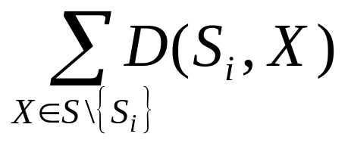
S₃ = -TT-C-TG-
S₄ = ATTGCATGC
D(S₃,S₄) = 4
D(S₁,S₂)+D(S₁,S₃)+D(S₁,S₄) = 9
D(S₂,S₁)+D(S₂,S₃)+D(S₃,S₄) = 12
D(S₃,S₁)+D(S₃,S₂)+D(S₃,S₄) = 12
D(S₄,S₁)+D(S₄,S₂)+D(S₄,S₃) = 11
Give a set S of k sequences, the center of this set of sequences is the sequences which minimizes

Slide 21
Align S₂ with S₁
S₁ = ATGCTC
S₂ = A-GAGC
Add S₃ by aligning S₃ with S₁
S₁ = ATGCTC
S₃ = -TTCTG
=>S₁ = ATGCTC
S₂ = A-GAGC
S₃ = -TTCTG

Slide 22

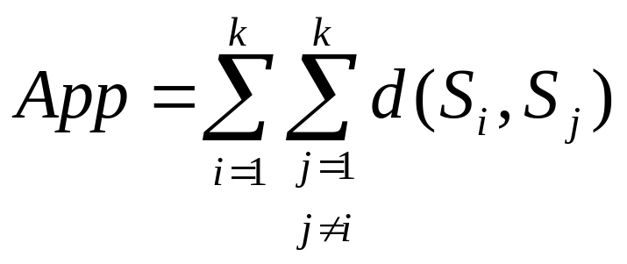
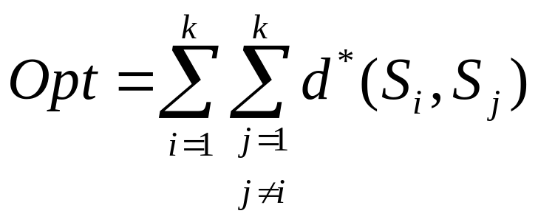
Add S₄ by aligning S₄ with S₁
S₁ = AT-GC-T-C
S₄ = ATTGCATGC
=>S₁ = AT-GC-T-C
S₂ = A--GA-G-C
S₃ = -T-TC-T-G
S₄ = ATTGCATGC
App 2Opt.

Slide 23
The Minimal Spanning Tree Preservation Approach for Multiple Sequences Alignment
S₁ = ATGCTC S₂ = ATGAGC S₃ = TTCTG S₄ = ATTGCATGC
Step1 finds the pair wise distances optimally by the dynamic programming algorithm.
S₁ = ATGCTC
S₂ = ATGAGC
D(S₁,S₂) = 2

Slide 24
S₁ = ATGCTC
S₃ = TT-CTG
D(S₁,S₃) = 3
S₁ = ATGC-T-C
S₄ = ATGCATGC
D(S₁,S₄) = 2
S₂ = ATGAGC
S₃ = TTCTG-
D(S₂,S₃) = 4

Slide 25
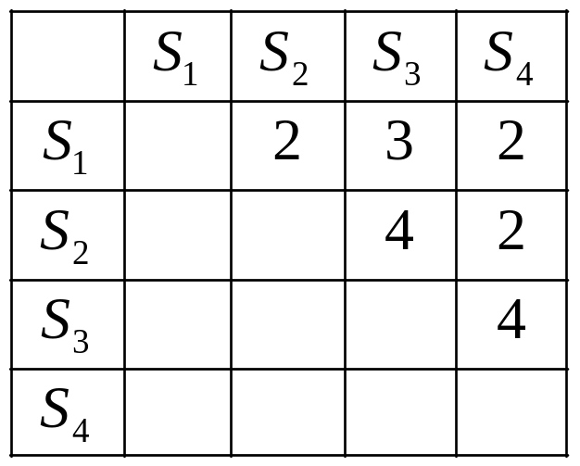
S₂ = ATG-A-GC
S₄ = ATGCATGC
D(S₂,S₄) = 2
S₃ = -TTC-TG-
S₄ = ATGCATGC
D(S₃,S₄) = 4
Table: The Distance Matrix D

Slide 26
S₁
2
3
S₂
S₃
2
S₄
A minimal spanning tree MST(D)
For e(S_{1,} S₂) S₁ = ATGCTC
S₂ = ATGAGC
For e(S_{2,} S₄) S₁ =(ATG-C-TC)
S₂ = ATG-A-GC
S₄ = ATGCATGC

Slide 27
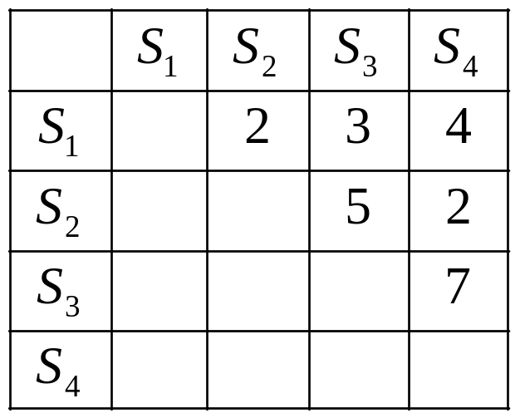
For e(S_{1,} S₃) S₁ = ATG-C-TC
S₂ =(ATG-A-GC)
S₃ = TT--C-TG
S₄ =(ATGCATGC)
Table: The Distance Matrix D_{m}

Slide 28
S₁
2
3
S₂
S₃
2
S₄
A minimal spanning tree MST(D_{m})
Theorem: MST(D) is equal to MST(D_{m}).
Corollary: Let e(a,b) and e(c,d) be two edges on MST(D). If D(a,b) < D(c,d), then D_{m}(a,b) < D_{m}(c,d).

